Slide 1

CUSTOMER CHURN PREDICTION
using Machine Learning
Japneet Kaur

Slide 2

PROJECT OVERVIEW
Business Problem
Customer churn refers to customers who stop using a company's products or services.
Businesses analyze churn to understand why customers leave and develop strategies to retain valuable customers.
Customer retention is cheaper than acquiring new customers.
Churn prediction helps increase profits.
Machine Learning can predict customers likely to leave

Slide 3

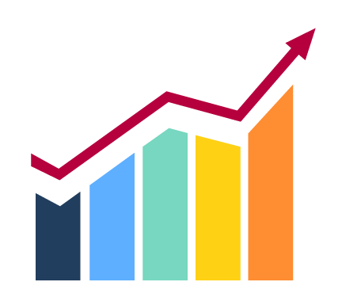
PROBLEM STATEMENT
Many businesses lose customers without understanding the reasons behind their decisions.
The objective is to build machine learning models capable of identifying customers who are likely to churn.
Objectives
Predict customer churn
Improve customer retention
Compare multiple ML algorithms
Find the best-performing model

Slide 4

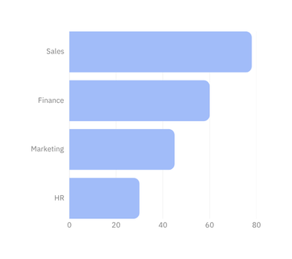
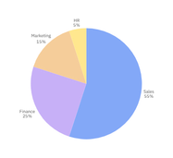

DATASET OVERVIEW
Features
Customer ID
Age
Gender
Subscription Type
Monthly Charges
Tenure
Contract
Payment Method
Internet Service
Churn (Target)
Dataset Distribution | Dataset Information
Category | Value
Training Samples | 440,833
Testing Samples | 64,374
Total Features | 12
Target Variable | Yes/No

Slide 5
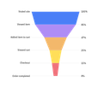






Raw Data
DATA PROCESSING
Data preprocessing is an essential step in machine learning that improves data quality before model training . It ensures that the dataset is clean, consistent, and suitable for accurate predictions.
Data Cleaning
Remove Duplicates
Removed Customer ID
Checked MissingValues
Removed Duplicates
One-Hot Encoding
Feature Scaling
Train-Test Split
One-Hot Encoding
Feature Scaling
Train-Test Split
Ready Dataset

Slide 6
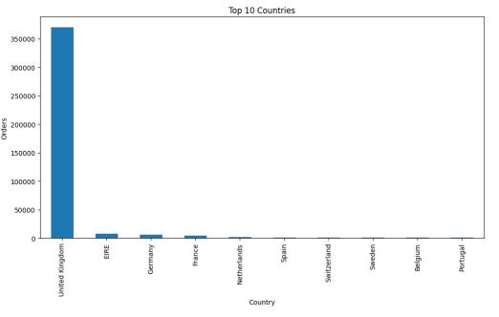
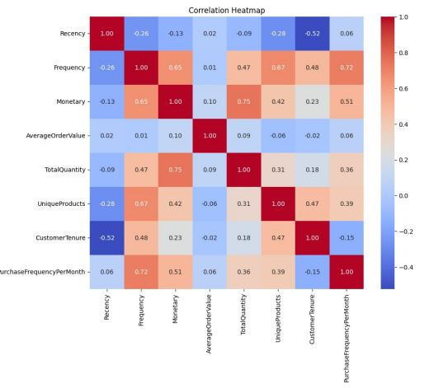
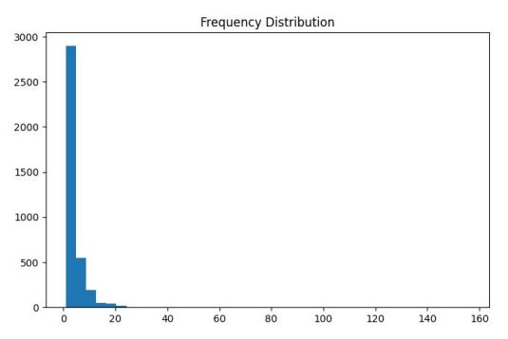
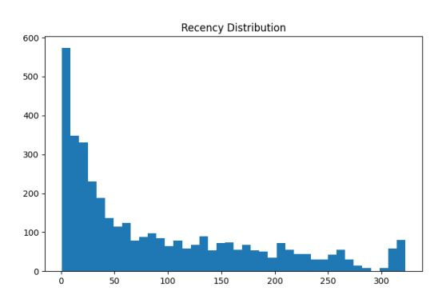
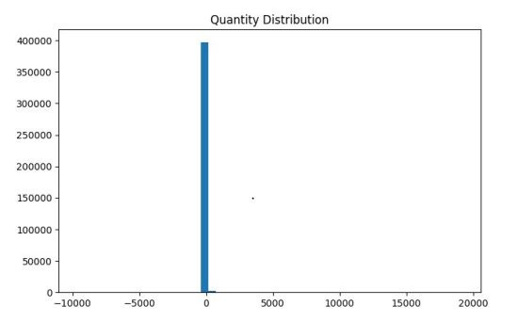
EXPLORATORY DATA ANALYSIS (EDA)
Top 10Countries
CorealationHeatmap
Frequency Distribution
Recency Distribution
Key Insights
✔ 73.5% of customers stayed, while 26.5% churned.
✔ Most customers are between 30–50 years of age.
✔ Monthly charges are generally between 20 and 80.
✔ The majority of customers use month-to-month contracts.
✔ Tenure and Total Charges show a positive relationship with customer behavior and help predict churn.
Quantity Distribution

Slide 7
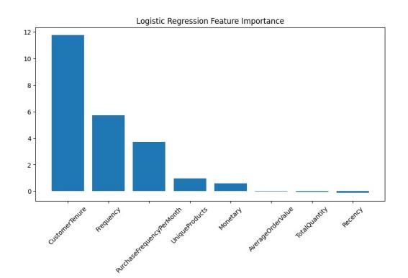
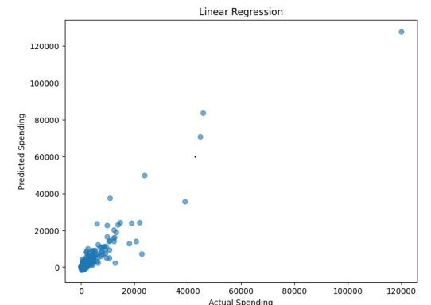
MACHINE LEARNING MODELS
Logistic Regression
Ridge Regression
Linear Regression

Slide 8
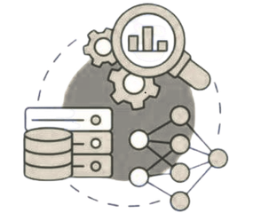




MODEL TRAINING PROCESS
Dataset
Train-test
Split
Feature
Scaling
Train
Models
Prediction
Evaluation

Slide 9
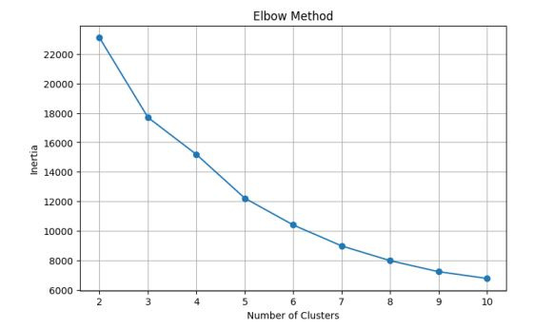
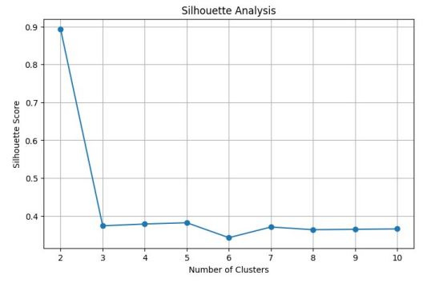
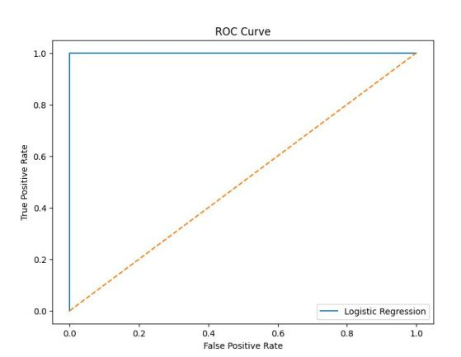
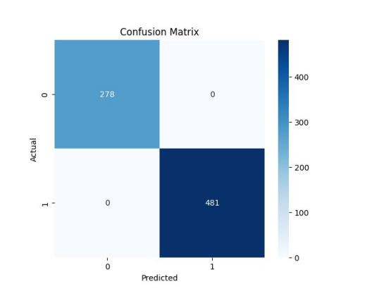
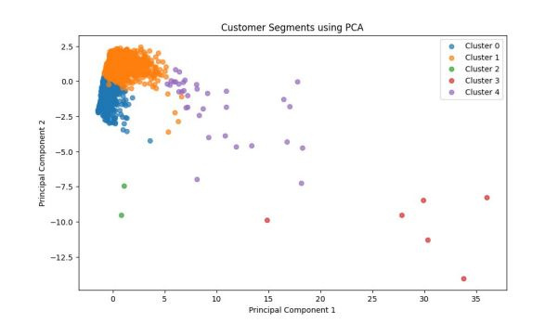
CUSTOMER SEGMENTATION
Silhoutte Analysis
Elbow Method
ROC
Confusion Matrix
PCA

Slide 10
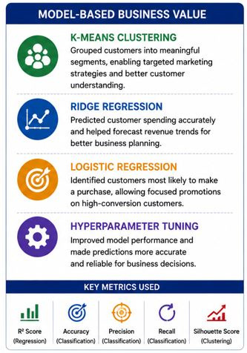
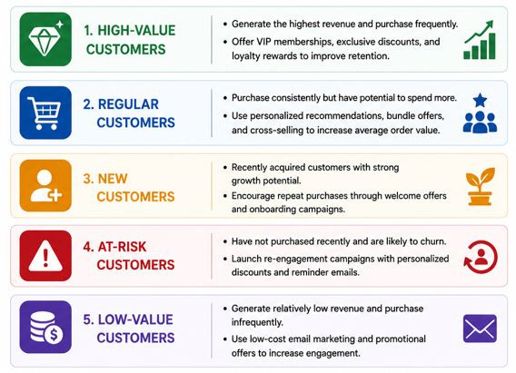
BUSINESS INSIGHTS
The machine learning models provide valuable insights that help the business understand customers better and take data-driven actions.

Slide 11
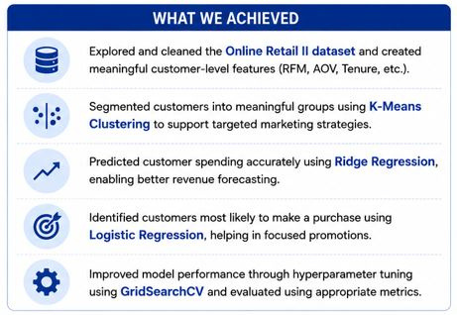
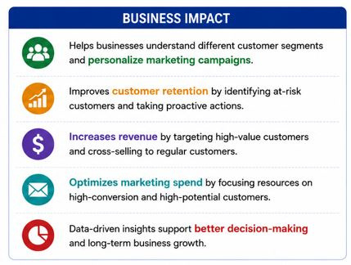
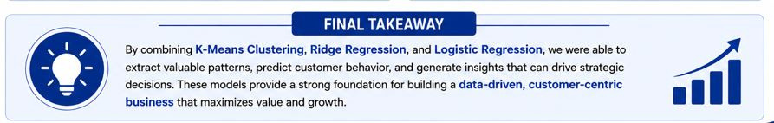
Conclusion

